Slide 1
Jargon vs Technical Vocabulary

Slide 2
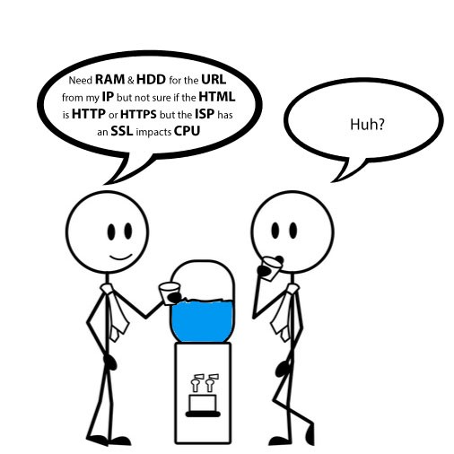

Slide 3
Definitions
Technical vocabulary has been referred to variously as:
‘discipline specific vocabulary’ (Woodward-Kron 2008)
‘domain-specific glossaries’ (Periñán-Pascual 2015)
‘scientific/technical terms’ (Yang, 1986)
‘specialised lexis’ (Baker 1988)
‘specialist terms’ (Woodward-Kron 2008: 239)
‘specialized vocabulary’ (Robinson 1980)
‘terminological words,’ ‘terms,’ or simply ‘terminology’ (Bečka, 1972: 47-48; Kit and Liu 2008; Peruzzo 2014)
‘terminological units’ (Cabré 1999).

Slide 4
Jargon is a vocabulary used by people with specialist knowledge, whereas technical term are simply official labels that have been adopted for certain concepts.
Both suggest wording that the population at large would find incomprehensible.

Slide 5
Jargon vs Technical Vocabulary
Intent of their use separates jargon from technical terms.
Words like cost, demand, price, supply are common technical terms in economics
Words like circuit, field, energy, and plate are common technical words in electronics

Slide 6
Jargon is thus both broader than and more restrictive than technical terminology
It includes words and phrases which may be informal in usage, but by the same token includes words and phrases that cannot be looked up in a manual.

Slide 7
Ex:The term PCB may mean Printed Circuit Board for an electronics professional but it might mean Pune Cantonment Board for a local politician.

Slide 8
Technical terminology is useful and necessary, whereas jargon's intent is to establish the speaker as an insider, recognizable to other insiders as "one of us"

Slide 9
jargon may have a looser and more informal meaning; that it may refer to terminology used even just in a particular workplace or between friends, possibly as 'shortcut terminology'

Slide 10
Slang is simply informal language, whereas jargon is specific to a group of people.

Slide 11
Examples of Medical Jargon
acute - a condition that comes on suddenly
agonal - term to signify a major, negative change in a patient's condition
atypical - something that isn’t completely normal
comorbid - two or more conditions that occur at the same time
iatrogenic - something that didn’t go as planned
idiopathic - a condition that does not have a clear explanation of cause
metabolic syndrome - a group of risk factors that increase the likelihood of heart attack and stroke
negative - results of a test that indicate a tested condition is not present
sub-therapeutic - something at a low level
tachycardia - fast heart rate

Slide 12
Business Jargon Examples
bang for the buck - a term that means to get the most for your money
best practice - the best way to do something
core competency - basic strength of a group or company
due diligence - putting effort into research before making a business decision
drill down - to look at a problem in detail
low-hanging fruit - the easiest problems to fix
scalable - an endeavor that can be expanded without a lot of additional investment
sweat equity - getting a stake in the business instead of pay
the 9-to-5 - business jargon meaning a standard work day
chief cook and bottle-washer - a person who holds many responsibilities

Slide 13
Legal jargons
Plaintiff – the person who begins a case in court.
Statutes – another term for the laws that govern a state or nation
Guardian Ad Litem - a person, can be an attorney or a trained volunteer, appointed by the Court to represent the best interests of a child or other person who is considered incapacitated by law due to age, illness, or mental condition.

Slide 14
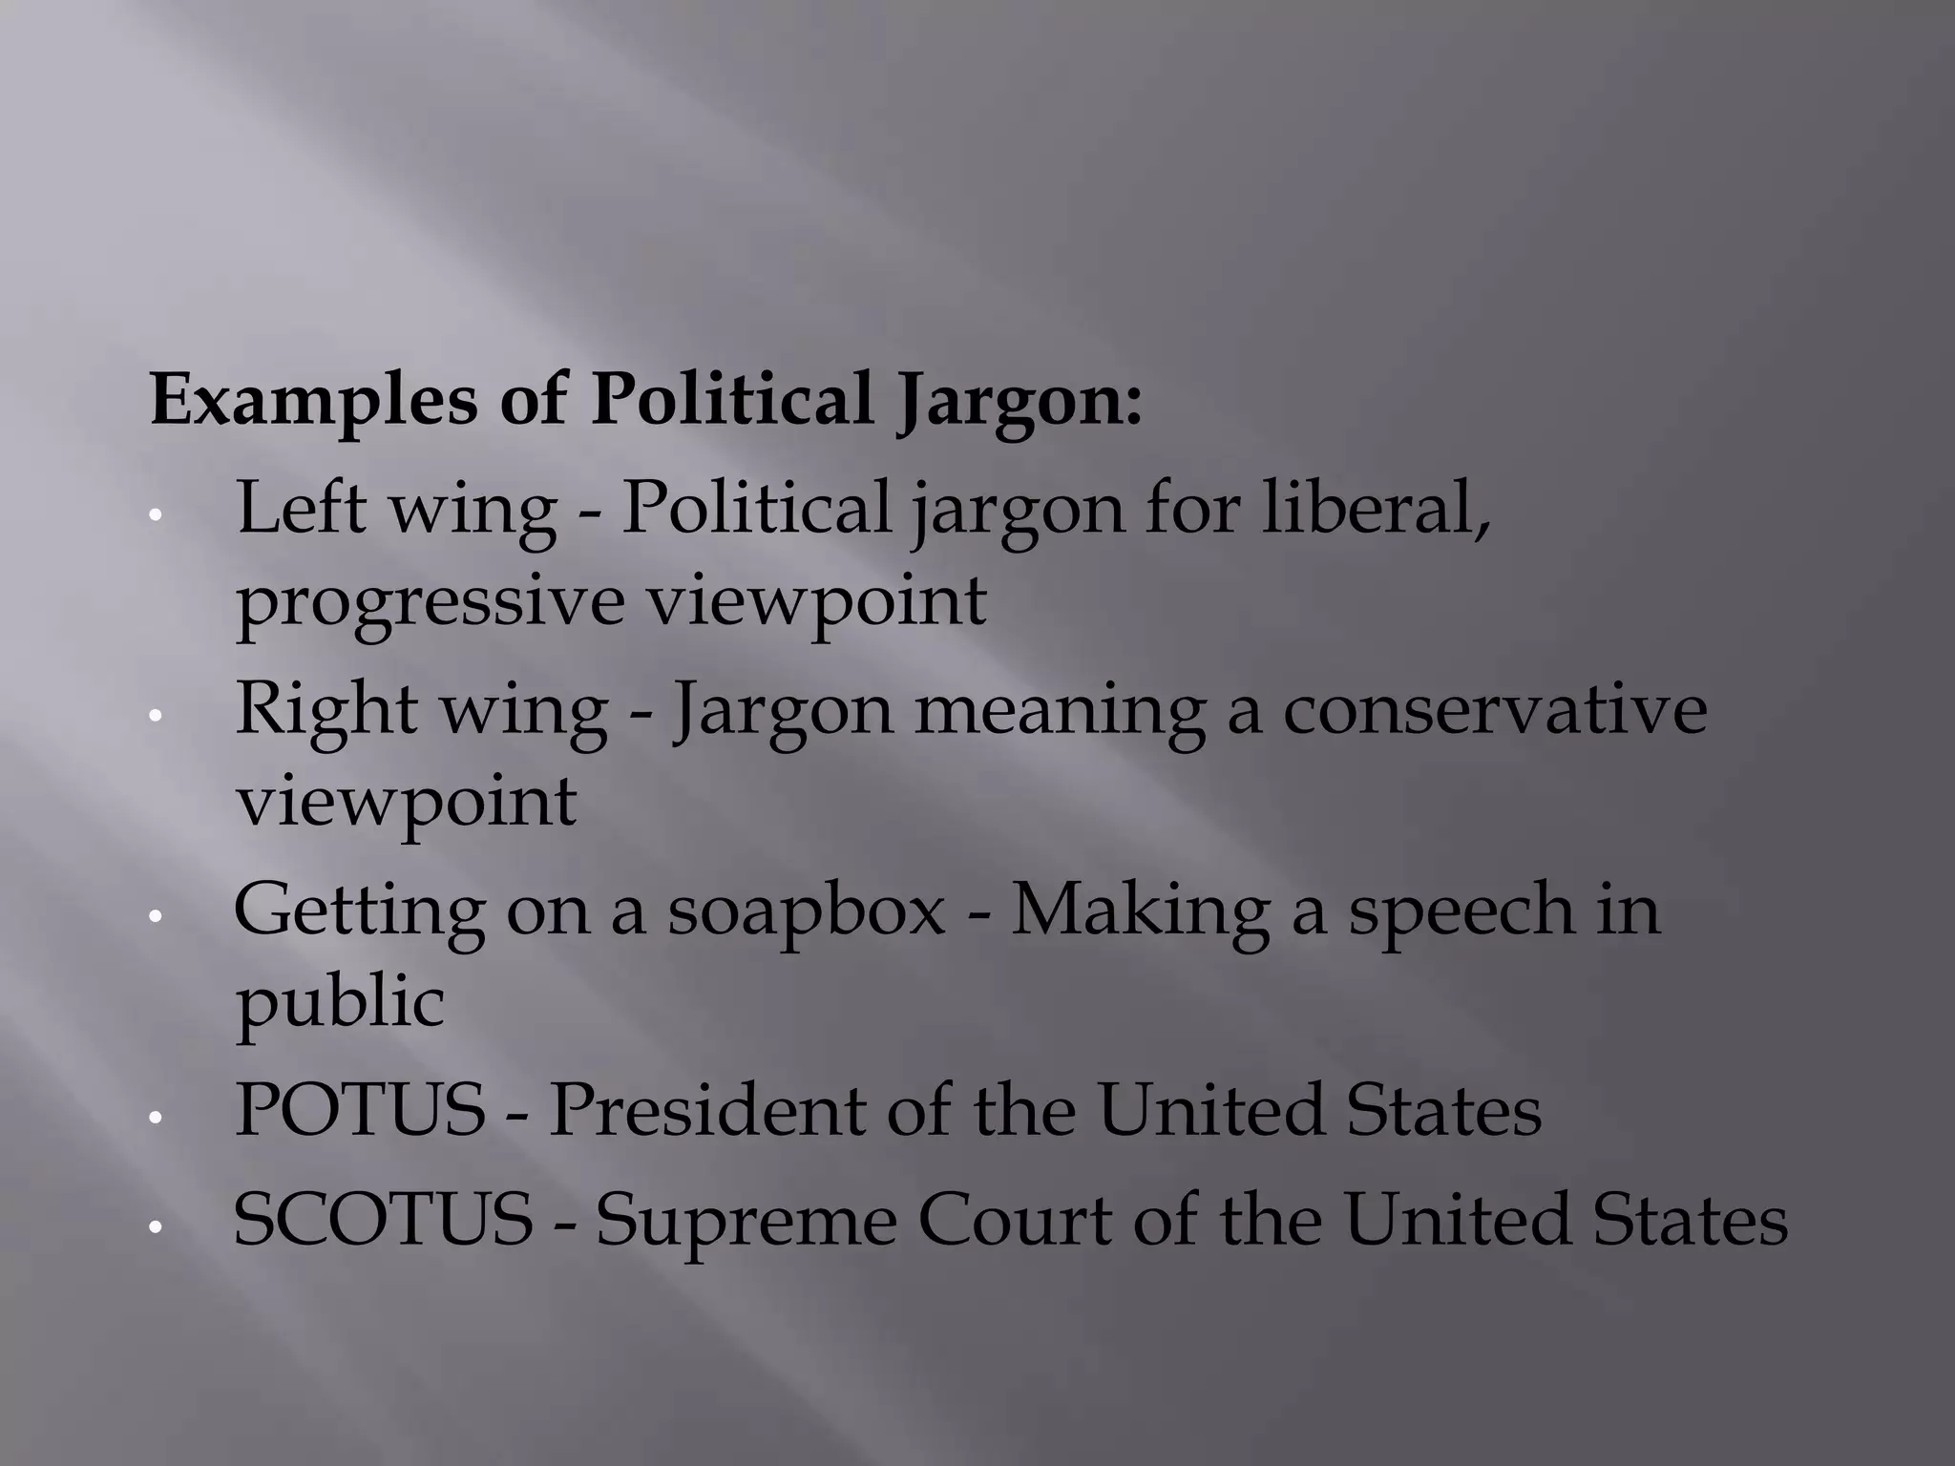

Slide 15
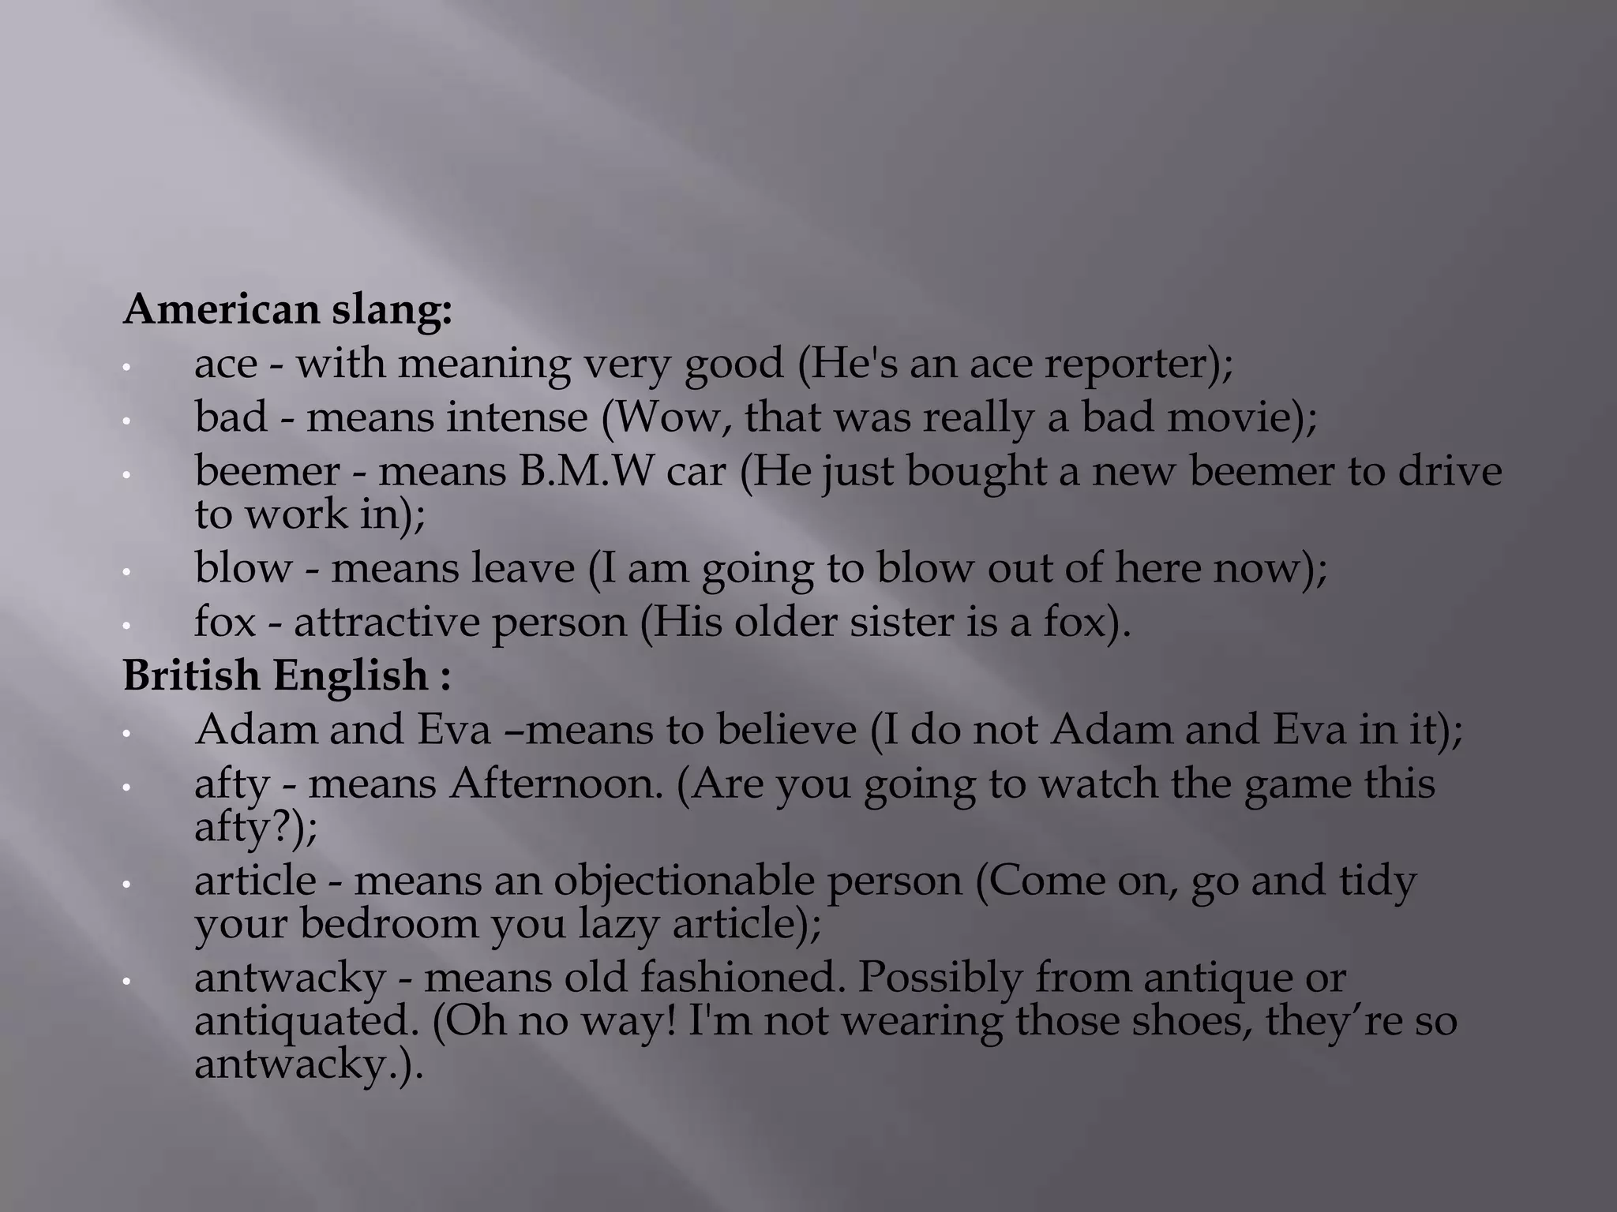

Slide 16
Appendix – Index – Glossary – References – Bibliography - Notes
Appendix: Can appear in the back matter, or in rare cases, at the end of a chapter.
Glossary: Provides definitions for uncommon words.
Index: Lists topics and where they appear in the document.
Bibliography: Also known as a reference list or works cited, this lists sources.
Notes: Can be included in the end matter
Footnotes and references are both ways to acknowledge sources in writing, but they differ in location and purpose:

Slide 17
Here are some examples of in-text citations in APA style:
Parenthetical: (Field, 2005)
Direct quotation: (Field, 2005, p. 14)
Web page with author: (Kraiser, 2011)
Web page with no author: (All things Nittany, 2006)
in-text references are usually included in the text itself while footnotes are given at the bottom of the page

Slide 18
chronology
appendix typically comes first, followed by the glossary, bibliography, contributors, and index
An appendix is any reference section appended to the back section of the book.
A glossary is a specific sort of appendix which contains the definitions of words and phrase found in the text that readers might not know the meanings of

Slide 19
Structure of Reports/Article
Vit logo
Title
Submitted by: submitted to
Title Abstract/Summary –keywords/index words
Introduction-background/overview-RQ,RO,Rationale
Methodology
ROL
Analysis of the Results & Discussion /Discussion-subcategories & RoL
Conclusion
Suggestions/Recommendations
References
Submit to a journal and attach the screenshot of your manuscript submission

Slide 20
Take print ,bind or staple it
Do not use a stick file

Slide 21
Thank you any questions

